Slide 1
Disclaimer
This training resource was developed to be used with the CZ ID platform
In October, 2026, stewardship of CZ ID transitioned to UCSF and the platform was renamed to SeqtoID
These training materials are not being actively maintained and may not reflect differences between CZ ID and SeqtoID, subsequent changes to the platform, or current methods and best practices in metagenomic sequencing and analysis

Slide 2

CZ ID mNGS Nanopore Pipeline
Rapid Response – Updated Sept 2026
Notes:
Slides updated 07/02/2024

Slide 3
mNGS Nanopore Pipeline Highlights
Developed in collaboration with bioinformatics team from Oxford Nanopore Technologies (ONT)
Pipeline accurately identifies microbes from a range of samples:
    Mock microbial communities
    Cell culture
    Humans (stool, nasal samples)
    Insects (mosquitos)
    Environmental (hot springs)

Slide 4
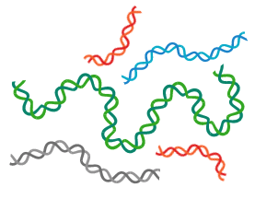


mNGS Workflow Overview
Sample Collection
DNA or RNA Extraction
Library
Preparation
Sequencing
Bioinformatic Analysis
Taxonomic Identification
Microbiome analysis
Discovery
mNGS

Slide 5
Focus for this workshop
Pathogen identification in stool samples and nasopharyngeal swabs

Slide 6
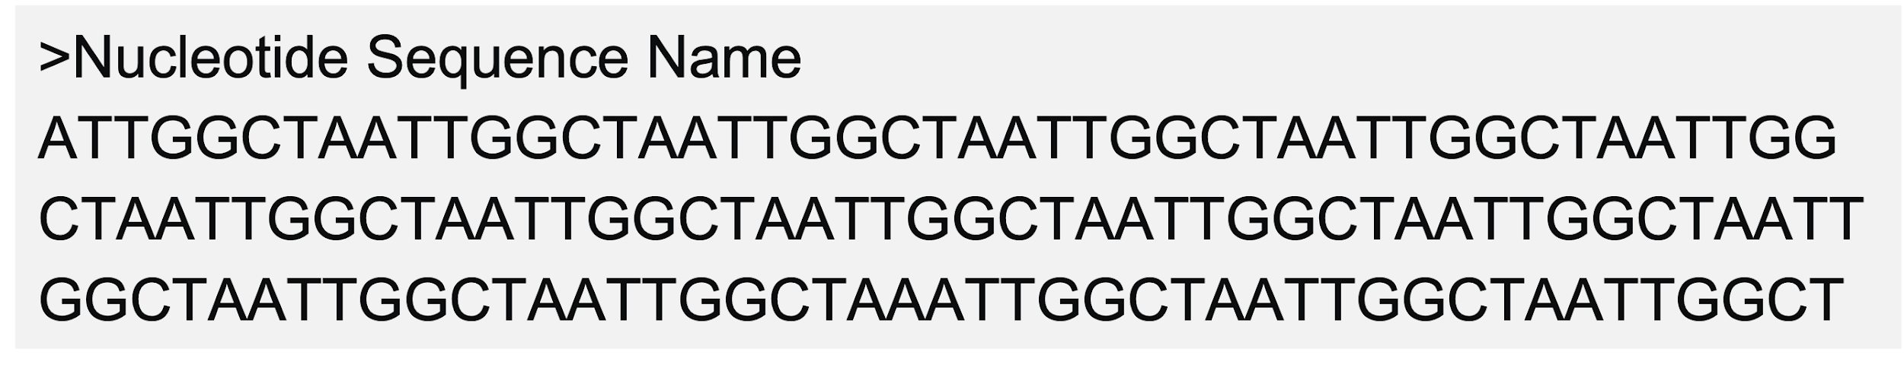
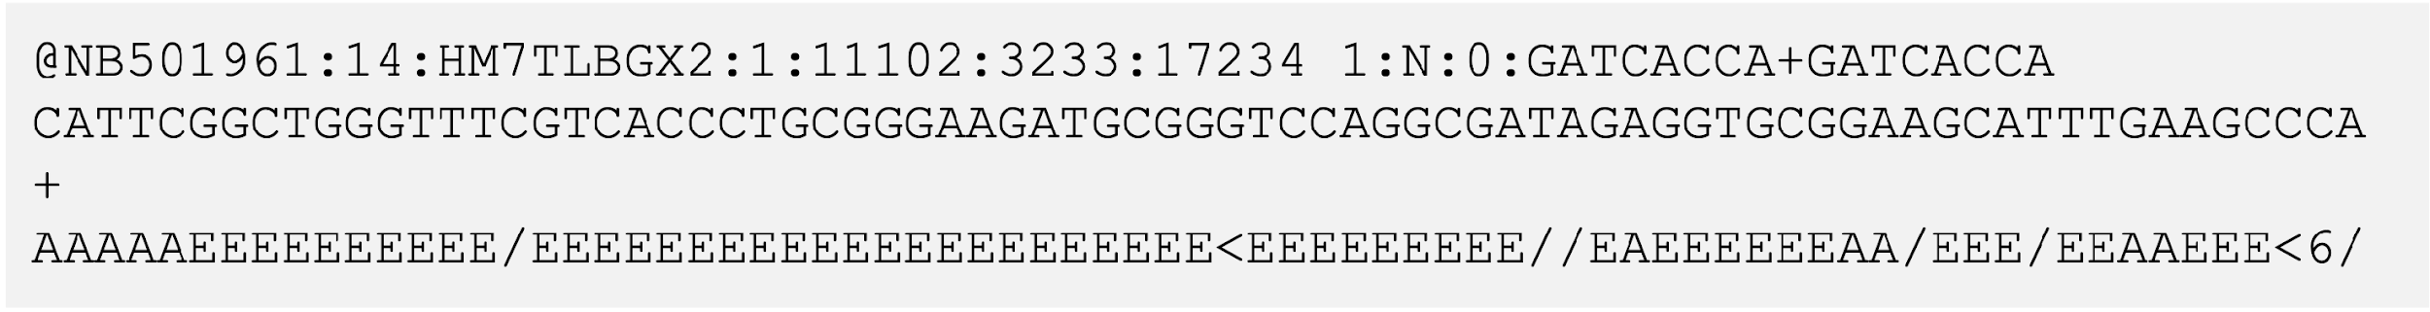
Sequence File Formats: FASTA vs FASTQ
Notes:
What’s what

Slide 7
Sequence File Formats
General
  FASTA
  FASTQ (Includes sequence identifier, sequence, and quality scores for base calls)
Nanopore-specific formats
  FAST5
  POD5

Slide 8
Nanopore Specific formats
Feature | POD5 | Older FAST5
File format | Binary (Apache Arrow-style, columnar) | HDF5-based (hierarchical)
Speed | High (parallel I/O optimized) | Slower with random access issues
Size | Smaller (less overhead) | Larger
Basecaller support | Dorado, Guppy (via pod5-api) | Guppy, older tools
Ecosystem | Actively maintained by ONT | Being phased out
Notes:
POD5 is analyzed in parallel any column can be accessed at any time, while FAST5 is hierarchical

Slide 9
mNGS Nanopore Pipeline Workflow CZ ID
Upload & Data Pre-processing
Notes:
Pipeline only accepts FASTQ files (FAST5 files must be converted)
You can upload files through the web app or command line interface (CLI)
            The ONT pipeline does not complete adapter/barcode trimming, so FASTQ files must be trimmed prior to upload
            Only one file per sample:
                Multiple FASTQ files for a given sample will be automatically concatenated if filenames follow a certain format and are associated with the same barcode (see Automatic Concatenation of Nanopore Files for details)
                If filenames do not follow the format recognized by the platform, you need to concatenate (or combine) them into a single file before upload
            Reads with midread barcodes detected should be filtered prior to upload (see more on the Prepare ONT fastqs for upload to CZ ID slide deck)
Nanopore data
(FASTQ files)

Slide 10
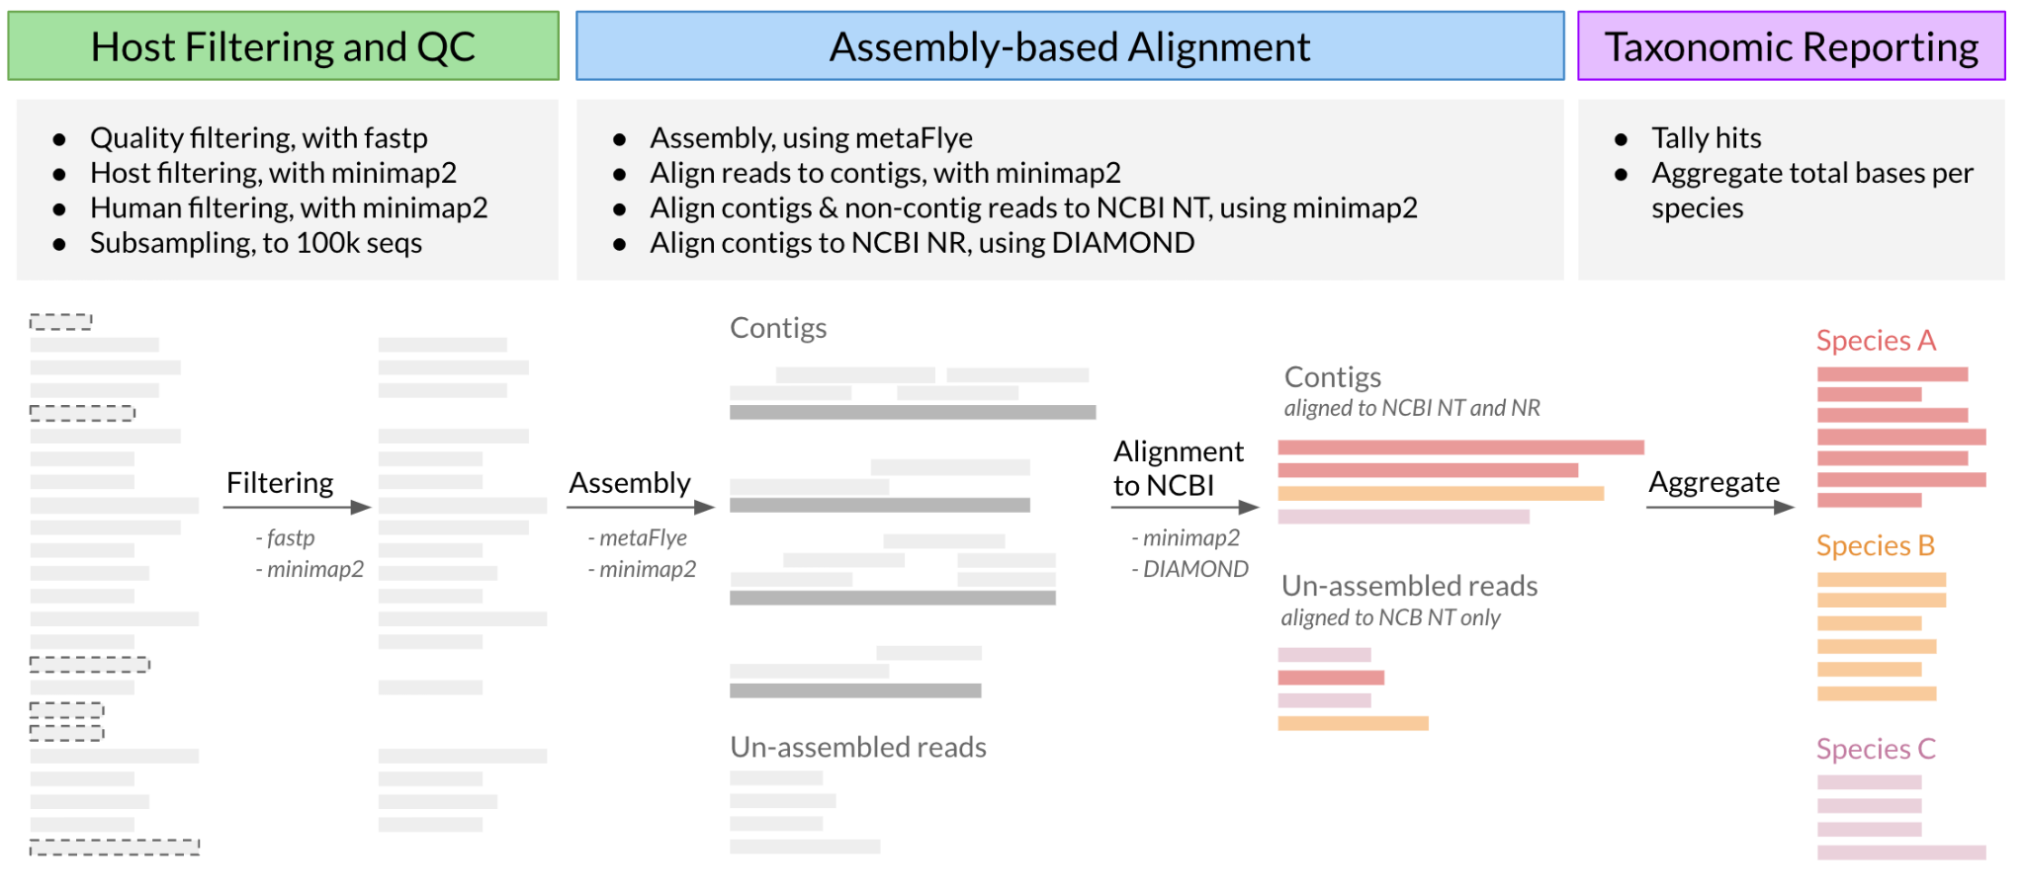
mNGS Nanopore Pipeline Workflow CZ ID
Upload & Data Pre-processing
Adapter trimming occurred on the basecaller software
Minimum Q ⩾ 9
Length ⩾ 100
Complexity > 30%
Host filtering is splice aware if input is RNA
Nanopore data
(FASTQ files)
Quality, Host & Human Filtering
(fastp & minimap2)
Subsampling to 1M reads

Slide 11
mNGS Nanopore Pipeline Workflow CZ ID
Upload & Data Pre-processing
Assembly & Mapping
Nanopore data
(FASTQ files)
Assembly
(metaFlye)
Contigs
Quality, Host & Human Filtering
(fastp & minimap2)
Subsampling to 1M reads
Notes:
metaFlye only assembles reads > 1kb
(in many cases we don’t see contigs)

Slide 12
mNGS Nanopore Pipeline Workflow CZ ID
Upload & Data Pre-processing
Assembly & Mapping
Nanopore data
(FASTQ files)
Assembly
(metaFlye)
Contigs
Mapping reads to contigs
(minimap2)
Quality, Host & Human Filtering
(fastp & minimap2)
Subtraction of contig-associated reads
(Samtools)
Subsampling to 1M reads
Unassembled reads

Slide 13
mNGS Nanopore Pipeline Workflow CZ ID
Upload & Data Pre-processing
Assembly & Mapping
Species Identification
Nanopore data
(FASTQ files)
Assembly
(metaFlye)
Contig alignment against NT and NR databases
(minimap2 & DIAMOND)
Contigs
Quality + Host Filtering
(fastp & minimap2)
Subtraction of contig-associated reads
(minimap2)
Unassembled read alignment against NT database
(minimap2)
Unassembled reads
Subsampling to 1M reads
Notes:
So if something doesn’t have an NR hot it is probably because is less than 1Kb

Slide 14
mNGS Nanopore Pipeline Workflow CZ ID
Upload & Data Pre-processing
Assembly & Mapping
Species Identification
Report
Nanopore data
(FASTQ files)
Assembly
(metaFlye)
Contig alignment against NT and NR databases
(minimap2 & DIAMOND)
Merge results
(Aggregate total bases per taxon)
Contigs
Sample Report
Host + Quality Filtering
(minimap2)
Subtraction of contig-associated reads
(minimap2)
Unassembled read alignment against NT database
(minimap2)
Unassembled reads
Subsampling to 1M reads

Slide 15
Things to note
mNGS Nanopore pipeline is limited compared to the Illumina pipeline
  No QC visualization on CZ ID
  No background models on CZ ID (more on that later)
  No consensus genomes on CZ ID
  No visualization to compare samples (heatmap, trees)
  Heatmap and background model alternative: No-code interactive app accessed via github
Notes:
https://github.com/gowtham-thakku/ont-heatmap
https://ont-heatmap.streamlit.app/

Slide 16
CZ ID mNGS Pipeline for ONT review complete!
Next Slides: DL5-O_QC and interpretation slides for ONT

Slide 17
Resources
Preprint describing the mNGS Nanopore pipeline and its implementation.
  CZ ID: a cloud-based, no-code platform enabling advanced long read metagenomic analysis
See “how-to” guides in CZ ID’s Help Center:
  Upload Nanopore Data
  Analyze Nanopore Data
To learn more about the pipeline, see Nanopore Pipeline Validation or click here to view pipeline changes over time.
“Mid-read” barcode trimming tool
Heatmap visualization and background subtraction tool

